Slide 1
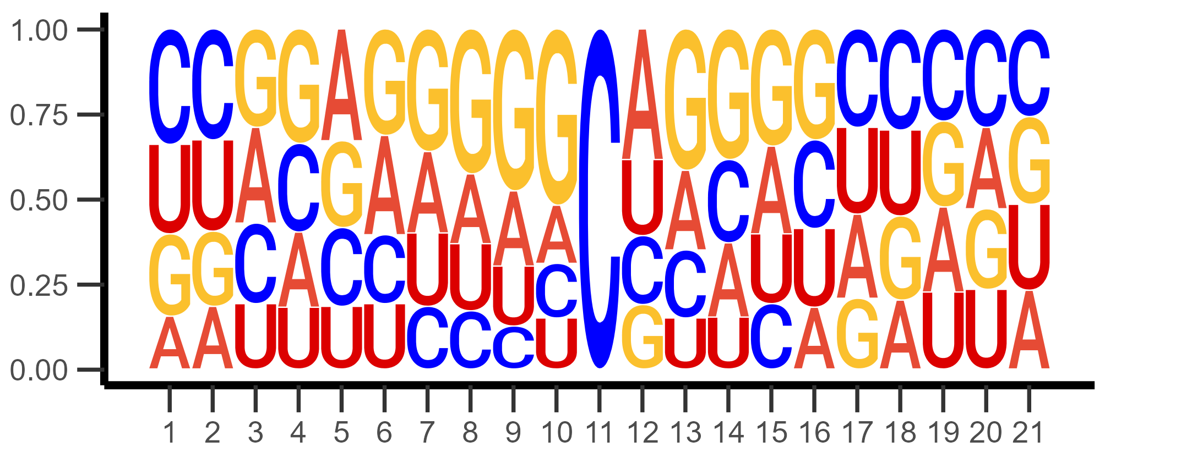
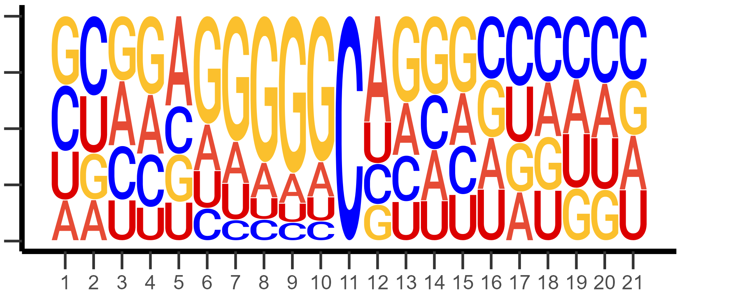
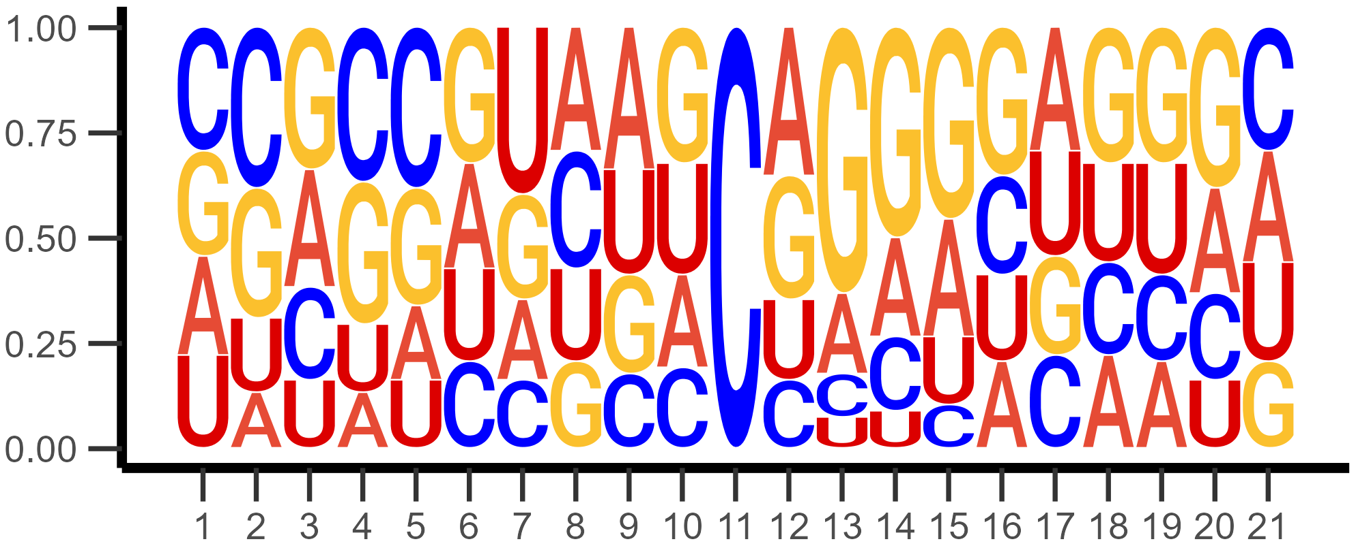
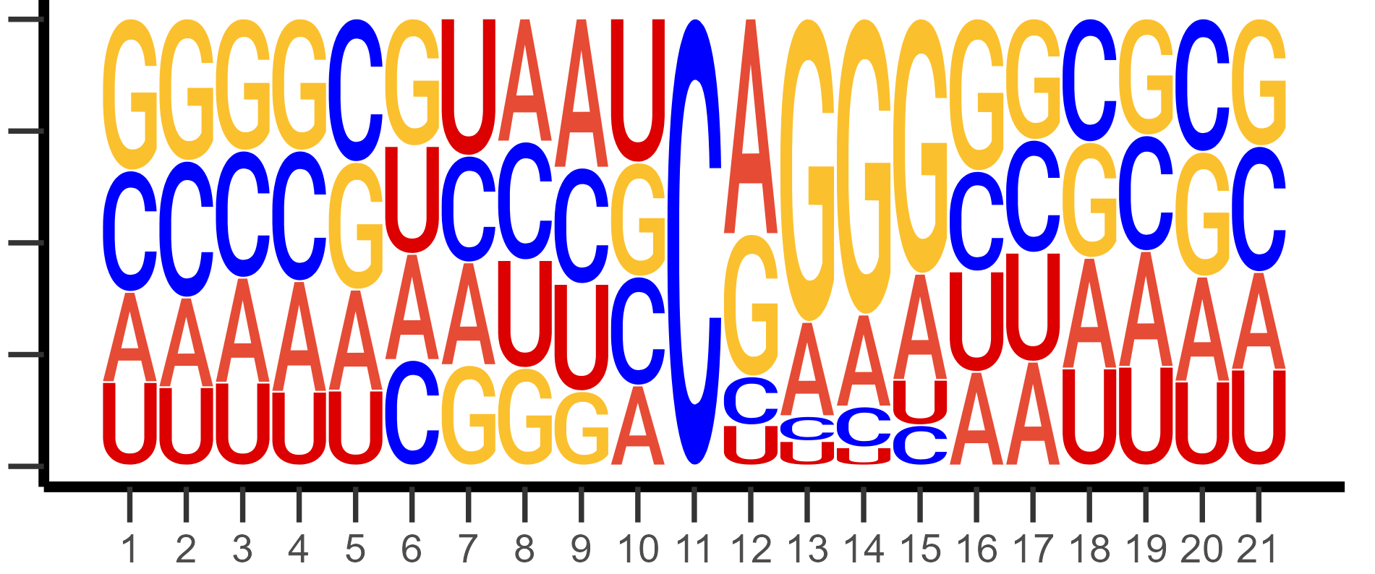
A
Without m-bias trimming
Mitochondrial RNA
Huang
Probability
Position (bp)
B
With m-bias trimming
Mitochondrial RNA
Huang
Probability
Position (bp)
Supplementary Figure 13. Sequence logo of p-m⁵C sites that passed all pipeline filters without (A) and with (B) 6 bp read-end trimming.

